Slide 1



Slide 2

Skin lesion Profiling For Cancer Detection
Supervised by:
Miss Sadia Ijaz
Group Members:
Waleed Khalid CIIT/FA17-BCS-009/ATK
Mian Muhammad Umer Hassan Khan Qureshi CIIT/FA17-BCS-040/ATK
14th Dec, 2020
Department of Computer Science
COMSATS University Islamabad, Attock Campus

Slide 3
Outline
_______________________________
Introduction
Related Work
Problem Statement
Objectives
Methodology
GUI
Tools

Slide 4
Introduction
_______________________________
Brain Tumor is rare but it is very dangerous if not cured in early stages.
Brain is the CPU of the body which contols all the functioning of the body.
Brain Tumpor is caused due to abnormal growth of cells in the brain.
Cancerous cells divide to generate new cancerous cells.Which cause it to grow all over the brain.

Slide 5
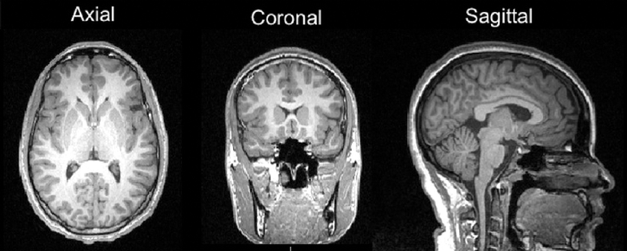
Introduction (continue)
Angles of brain MRI :
Axial
Coronal
Sagittal

Slide 6
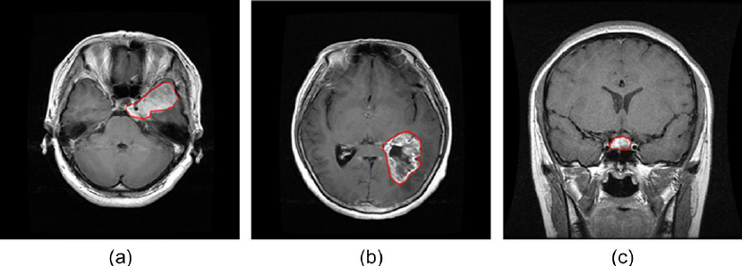
Introduction (continue)
Type of Brain Tumor:
(a) Meningioma
(b) Pituitary
(c) Glioma

Slide 7
Problem Statement
______________________ ________
Conventional methods consume high computational power and show less accuracy.
Diagnosis of Brain Tumor is essential at earlier stage.
Expand the different types of visual characteristics such as color, textural features etc to differentiate the Tumor type.
Limited research is done in multi-classification of Brain Tumor detection.

Slide 8
Objectives
______________________________
Develop well organized Automated Brain Tumor classification system which has accuracy, low complexity and performance.
Reduce the number of false detections.
System will automate the analysis and help Neurologists to do fewer tasks and achieve reliable results.

Slide 9
Related Work
_______________________________
KNN:Use normal,begnin and melignant brain tumor images.KNN classification depends on determination of K value,determination of class and distant calculation between the query instant and training samples.
DNN: Classified four type of tumor classes.walvet transformation and feature extraction tool use in model.
Support Vector Machine: This algorithm classifies the tumor type sucessfully.High computational time and physical memory consumption.Perform feature extraction by applying gray scaling.

Slide 10
Methodology
_______________________________
We have analyzed all past techniques of machine learning and after reviewing their drawbacks we proposed “Convolution Neural Network” classifier that will yield maximum accuracy according to research.
Pre-Processing
Segmentation
Feature Extraction
Classification

Slide 11
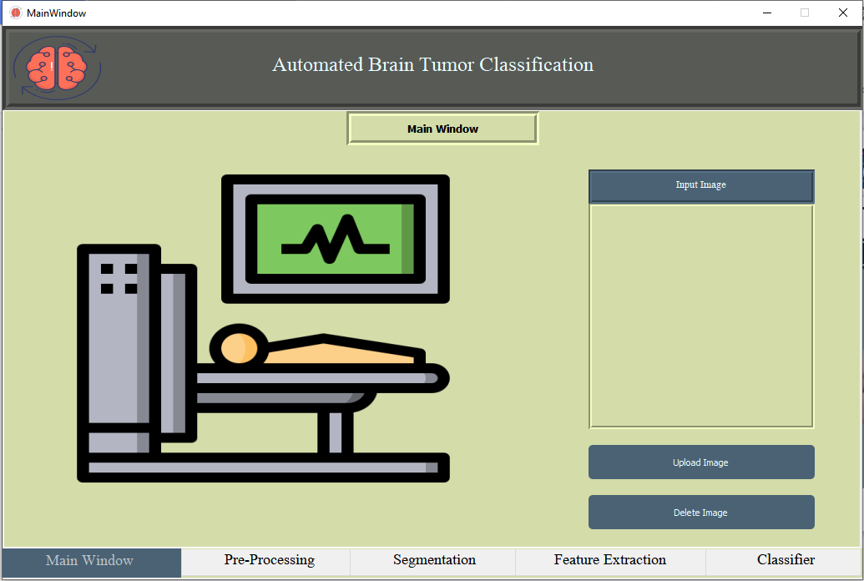
GUI
_______________________________

Slide 12
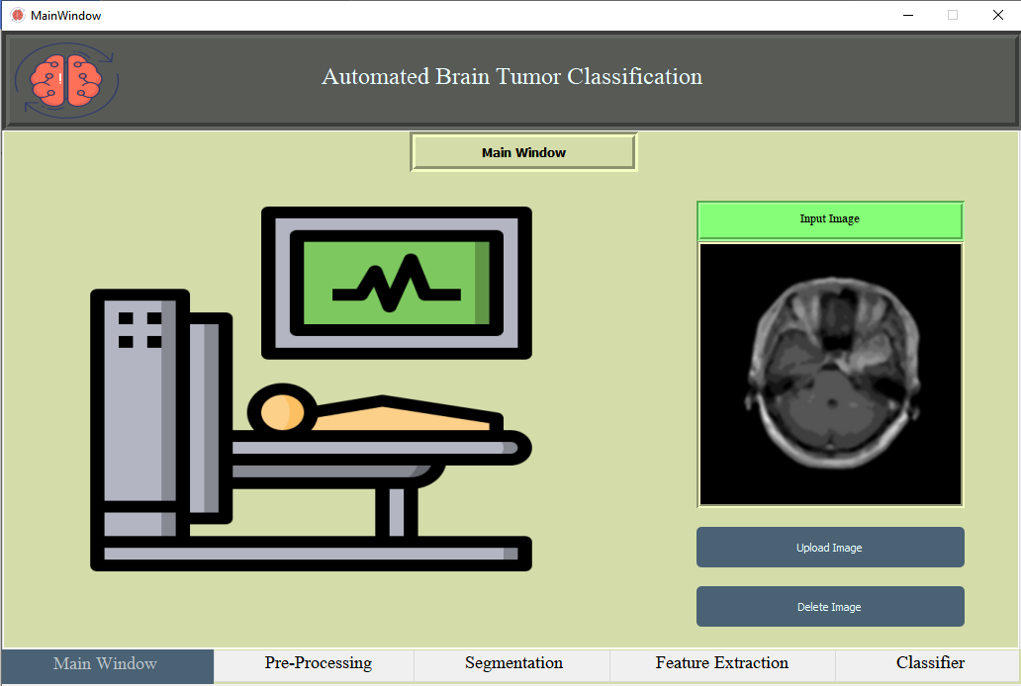
GUI
_______________________________

Slide 13
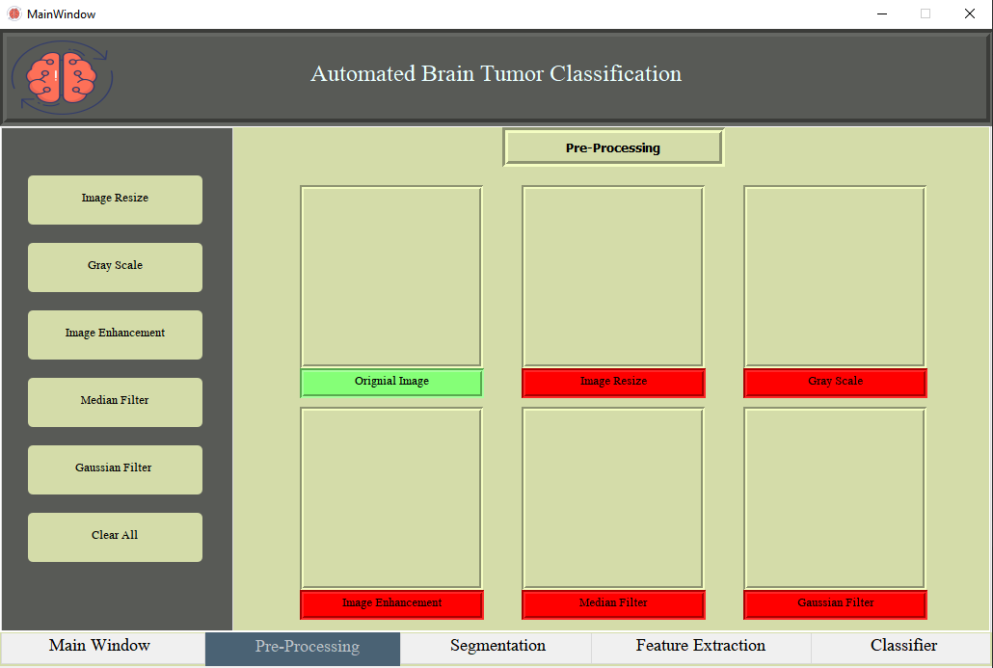
GUI
_______________________________

Slide 14
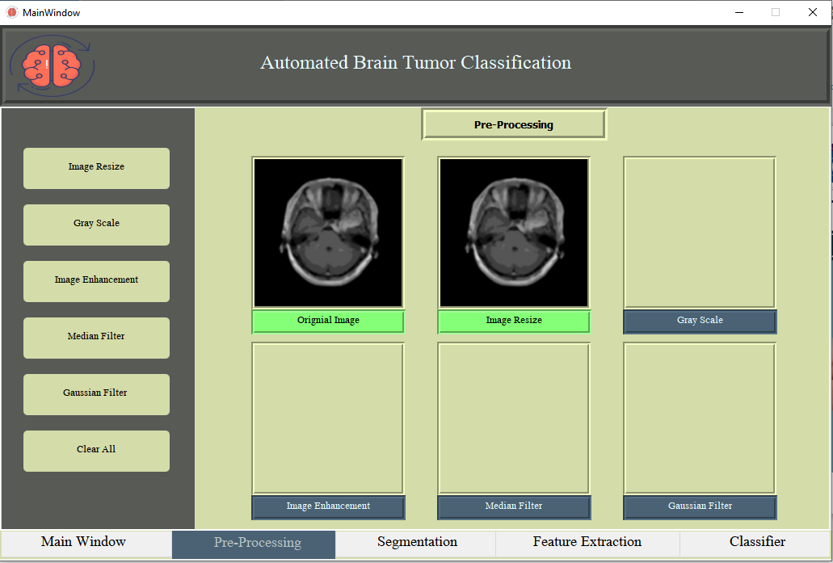
GUI
_______________________________

Slide 15
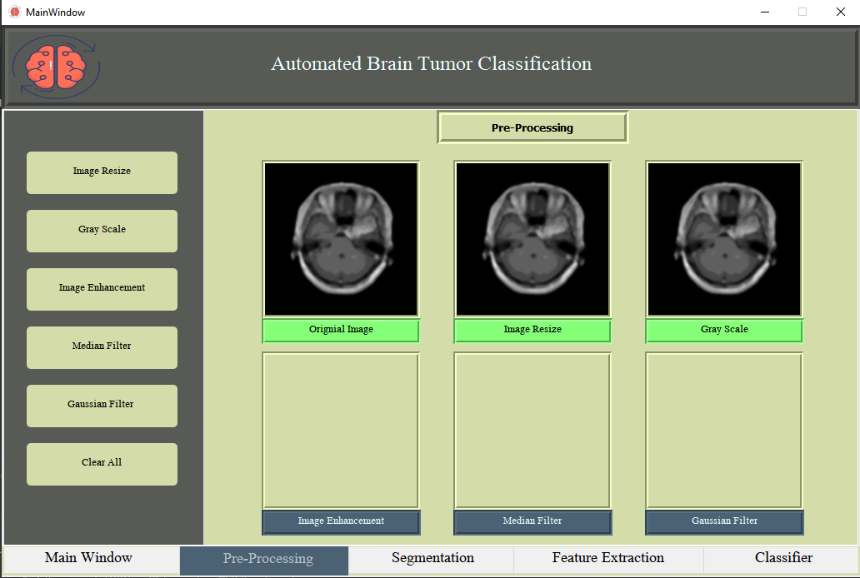
GUI
_______________________________

Slide 16
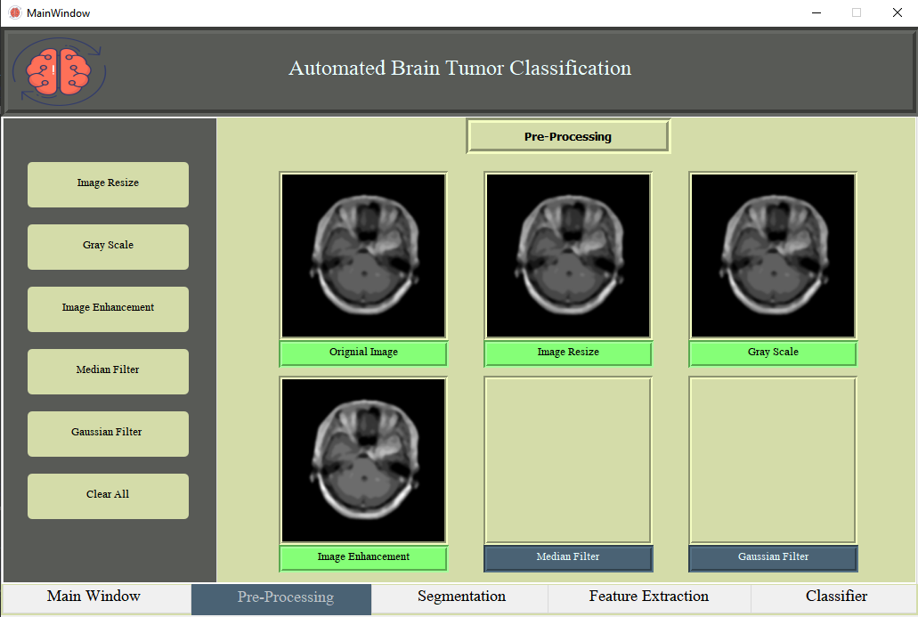
GUI
_______________________________

Slide 17
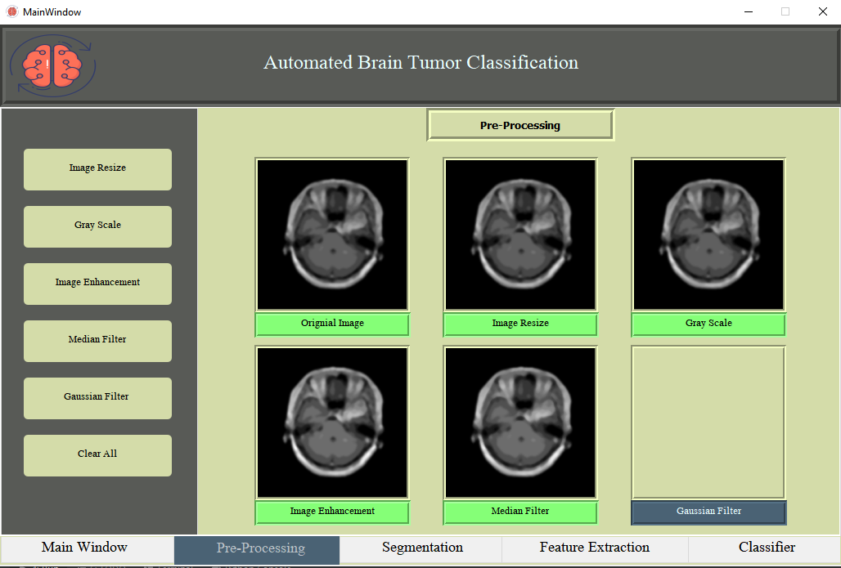
GUI
_______________________________

Slide 18
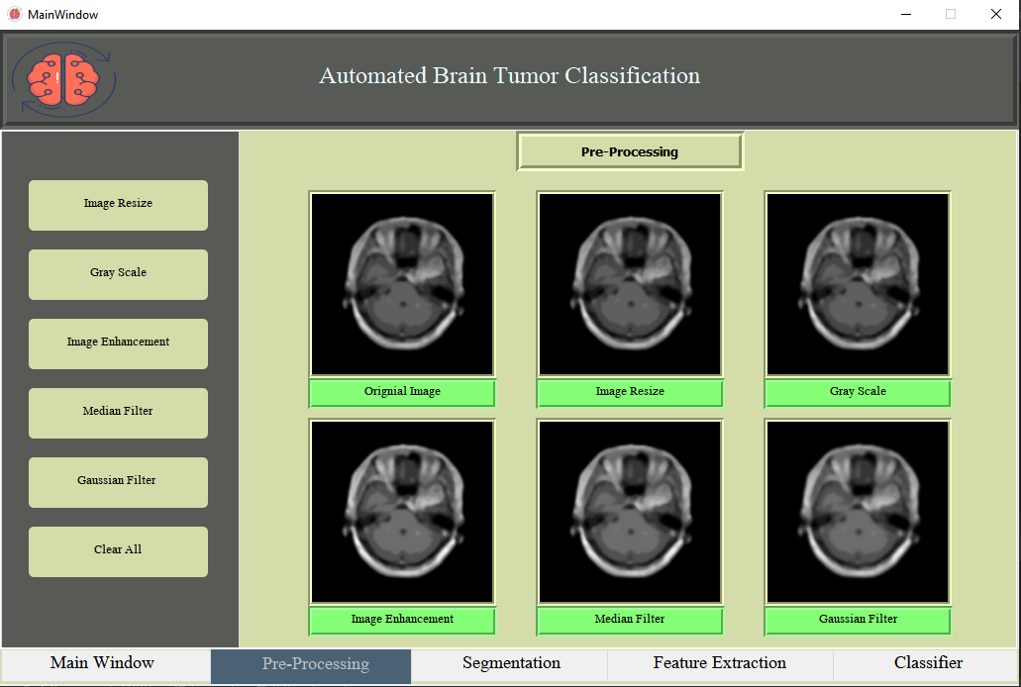
GUI
_______________________________

Slide 19
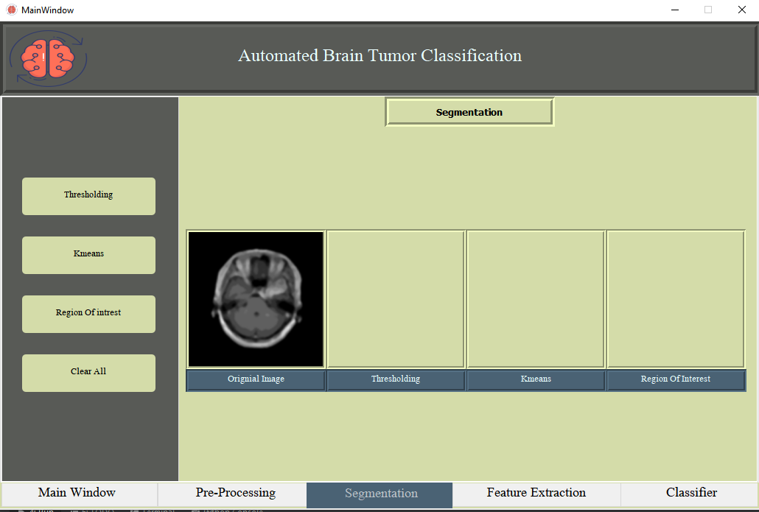
GUI
_______________________________

Slide 20
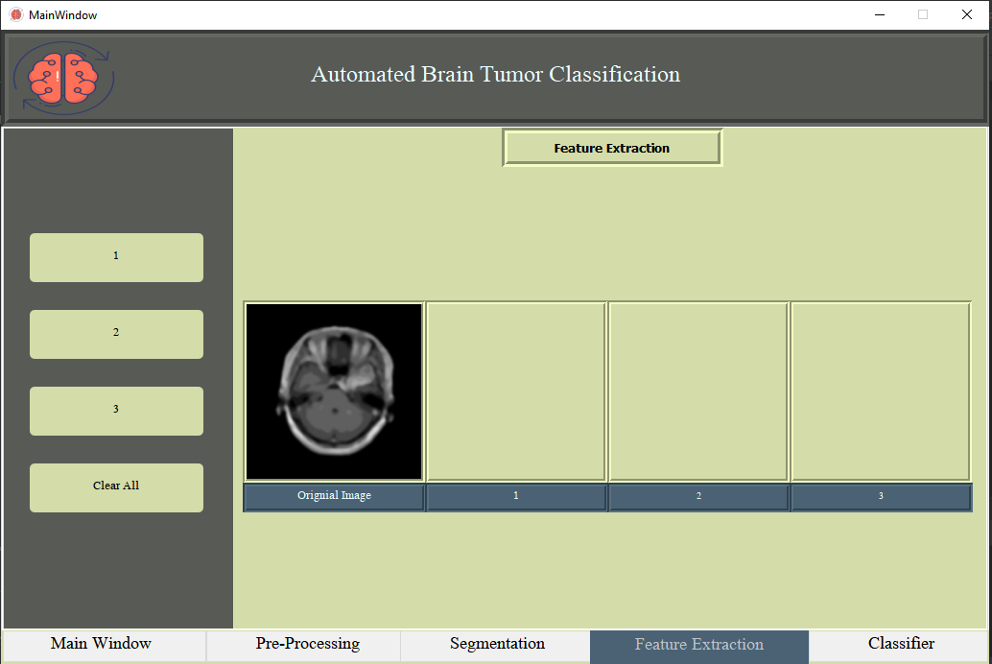
GUI
_______________________________

Slide 21
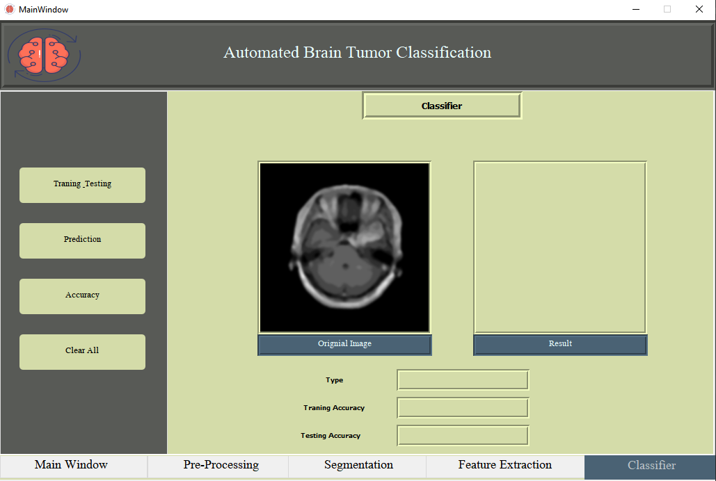
GUI
_______________________________

Slide 22
Tools
_______________________________
PyCharm.
MS Word.
MS Power Point.
Python 3.7 IDE.
PyQt5 Designer.
Anaconda.
_______________________________

Slide 23


